Slide 1
System Architecture
Unit 04

Slide 2
System Architecture
System Architecture for SDI
Interoperability
Interoperability and standards
Client Server Architecture

Slide 3
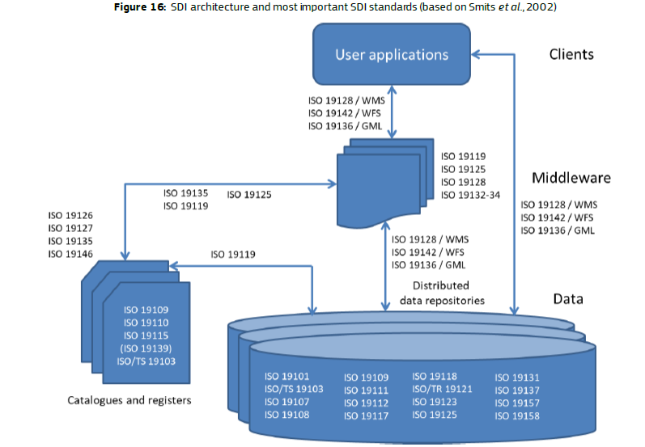
4.1 System Architecture for SDI

Slide 4
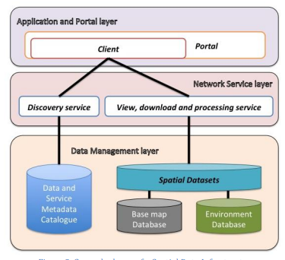
General schema of a Spatial Data Infrastructure

Slide 5
System Architecture for SDI
One can propose three different models to collect and share data, these are also different models to support each participants in data management process
Model A: A country hasn’t SDI and do not want to replicate it in the Organization or to require for security reasons to not federate own system with the central node, can use only the central one developed.
Model B: A country has a SDI, but it’s not at all developed to be interoperable with central node and it wants also to improve its technological components, or it wants to build a new one. In this case it can replicate one or more software part and after a configuration procedure, it can federate its SDI with the central one.
Model C: A country has a SDI well organized and also interoperable in according with the international standard; it can federate directly with central node.

Slide 6
System Architecture for SDI
The main components, following the general architecture of SDI defined are:
Spatial Data Management system to store, query and manage directly the data in the database.
A Catalogue system with a specific discovery service to harvest, search and query metadata and with integrated Metadata editor;
Network Service system based where data are distributed and elaborated via Web Service (mainly following OGC Standard);
A portal within a client to search, view, query and analyse the spatial data;

Slide 7
Spatial Data Management system (opensorce based)
This component is the Database software based on PotgreSQL and POSTGIS as spatial extension to support geographical features.
Both software are open source software and as Database Management system can used with GIS software, like QGIS or a Database Administration Tool like pgAdmin (both are open source software as well).
For instance, the platform provides also an opportunity to charge directly data and geographical feature in the PotgreSQL store.

Slide 8
Catalogue system
The catalogue itself is an instance within the database but with specific data type to manage the content of metadata files.
The software to manage and edit the metadata is embedded in the GeoNode component

Slide 9
Network Service system
The software component to support the web service for data distribution and elaboration is based on the open source Geoserver that is interlinked with GeoNode and it is able to deploy web services for view (OGC WMS – View Map Service), for download and query select (OGC WFS – Web Feature Service, OGC WCS - Web Coverage Service) and for specific elaboration and calculation (OGC WPS – Web Processing Service).

Slide 10
Portal and Client system
Such system is the platform that represents the portal for the management and publication of geospatial data in a collaborative way, but also for developing geospatial information systems (GIS) that is based on the software package e.g. GeoNode, where most of the other components are embedded in order to simplify to the user the possibility to create and manage data, layer, map and metadata repository.
In the platform, it is also integrated the client part based on software component (e.g. GeoExplorer) to allow to the user the view and publication of data and maps.

Slide 12
4.2 Interoperability
Interoperability in GIS (Geographic Information System) and Spatial Data Infrastructure is vital for seamless data integration and sharing across different platforms.
It refers to the ability of different systems to exchange spatial data and communicate effectively.
This interoperability is crucial as GIS technology plays a significant role in managing, analyzing, and visualizing spatial data for various applications such as urban planning, environmental management, and emergency response.

Slide 13
4.2 Interoperability
Achieving interoperability requires standards such as OGC (Open Geospatial Consortium) specifications to ensure consistency in data formats, encoding schemas, and service interfaces.
It enables diverse stakeholders like government agencies, private organizations, and citizens to access and utilize geospatial information efficiently.
By promoting interoperability in GIS and SDI, organizations can overcome barriers related to data silos, enhance collaboration among different departments or entities, make informed decisions based on accurate geospatial insights, and support sustainable development initiatives at local, regional, and global levels.

Slide 14
Software components to build SDI
The opensorce based SDI can be built for example using the following software
PostgresSQL and PostGIS:
QGIS
GeoServer
GeoNode

Slide 15
Software components to build SDI - PostgresSQL and PostGIS (1/3)
PostgreSQL is a powerful, open source object-relational database system (ORDBMS) that uses and extends the SQL language combined with many features (complex queries, foreign keys, updatable views, multi-version concurrency control, data type, etc.) that safely store and scale the most complicated data workloads.
PostgreSQL has a proven architecture, reliability, data integrity, robust feature set, extensibility
PostgreSQL is extensible software where is possible to custom functions, even write code from different programming languages without recompiling your database.

Slide 16
Software components to build SDI - PostgresSQL and PostGIS (2/3)
PostGIS is an open source extension for the PostgreSQL Database Management System that adds spatial feature functions such as distance, area, union, intersection, and specialty geometry data types to the database.

Slide 17
Software components to build SDI - PostgresSQL and PostGIS (3/3)
With pgAdmin we can create a database instance from the scratch, defining the ownership and the functionality to be available for each user.
It supports all PostgreSQL features, from writing simple SQL queries to developing complex databases or to query an active database (in realtime), allowing to the user to control modifications and implementations.

Slide 18
Software components to build SDI QGIS
This software is GIS open source desktop software, mainly used to view and manage the geographical information and data, it supports a number of raster and vector data formats, with new format support easily added using the plugin architecture.
From its functionality is available the DB Manager Plugin that is one of the main and native tools to integrate and manage spatial database formats supported by QGIS.

Slide 19
Software components to build SDI GeoServer
GeoServer has a browser-based web administration interface application used to configure all aspects of GeoServer, from adding and publishing data to changing service settings.

Slide 20
Software components to build SDI GeoNode
The GeoNode platform includes as default software to setup the Spatial Data management system (but can be integrated with other software components installed and configured separately) the following are the internal software elements:
DJango.
GeoServer (Web service deployment software)
PostgresSQL and PostGIS (Database and spatial extender plug-in)

Slide 21
Data elements
The data elements are built as blocks of tables and in DD data elements are divided in two groups:
non-common elements
common elements

Slide 22
Data elements - non-common elements
non-common elements belong into a certain single table and they cannot be used in any other table.
They are defined within that certain table and they do not have a “life” outside of that table.

Slide 23
Data elements - common elements
common elements are not strictly attached to a single table.
Instead, they can be used in many tables.
They are potential candidates to be used in many datasets and tables and thus have been harmonised to avoid repetitions.
A perfect example of a common element is CountryCode, whichcan modeled as a vocabulary list.

Slide 24
Data elements - common elements
Each data element can be divided by different value domain in:
Data elements with fixed values (i.e. code lists terms).
Data elements with quantitative values (i.e. measured values)
Data elements with values from a vocabulary have a linked vocabulary. The vocabulary concept values are valid values for the common data element.

Slide 25
4.4 Client Server Architecture (1/2)
Client-server architecture is a crucial component of spatial data infrastructure.
It refers to a distributed computing model where tasks and responsibilities are divided between clients, typically end-user devices, and servers, which provide resources and services.
In this architecture, clients initiate requests for data or computation, while servers respond to these requests by processing the data or executing the requested functions.
Spatial data infrastructure relies on client-server architecture to efficiently manage and deliver geospatial information across networks.

Slide 26
4.4 Client Server Architecture (2/2)
The server components in this setup play a central role by storing large amounts of spatial data and performing complex analyses to fulfill client requests.
By utilizing client-server architecture, organizations can ensure that their spatial data infrastructure is capable of handling multiple users simultaneously, with efficient data retrieval and processing capabilities in place.
This architectural framework promotes scalability, security, and proper management of spatial datasets in today's increasingly interconnected world.

